Slide 1

Seasonal Agriculture Performance Analysis
Shravani Waghawale
Nutan College of Engineering and Research, Pune
AICTE STU ID : STU685445520d8961750353234

Slide 2

PROBLEM STATEMENT
Agricultural activities are influenced by seasonal variations in environmental conditions, farming practices, resource availability and market conditions. As a result, agricultural performance may differ from one season to another. However, raw agricultural data does not clearly explain how agricultural performance changes across seasons or what patterns can be observed in different seasonal conditions.
The project analyzes seasonal differences, patterns, trends, relationships and variations in agricultural performance.

Slide 3
Project Description
The project focuses on analyzing agricultural activities across Kharif, Rabi and Zaid seasons.
The dataset contains information about:
Crop production and yield
Rainfall, temperature and humidity
Soil moisture
Fertilizer and irrigation
Water usage and efficiency
Revenue, cost and profit
Disease and pest risk
State and district information
The analysis was performed using Python, Pandas, NumPy, Matplotlib and Seaborn.
The objective is to discover seasonal patterns and generate data-driven insights and recommendations.

Slide 4

WHO ARE THE END USERS?
Farmers – to understand seasonal crop performance and resource usage.
Agricultural Planners – to support seasonal agricultural planning.
Government & Agriculture Departments – to identify regional and seasonal trends.
Agricultural Researchers – to study relationships between environmental conditions and agricultural outcomes.
Agribusinesses – to understand production, revenue and profitability patterns.

Slide 5

Technology Used
Libraries
Pandas
NumPy
Matplotlib
Seaborn
Development Environment
Jupyter Notebook
Analysis Techniques
Data Cleaning
Exploratory Data Analysis
Statistical Analysis
Correlation Analysis
Data Visualization
Comparative Analysis

Slide 6
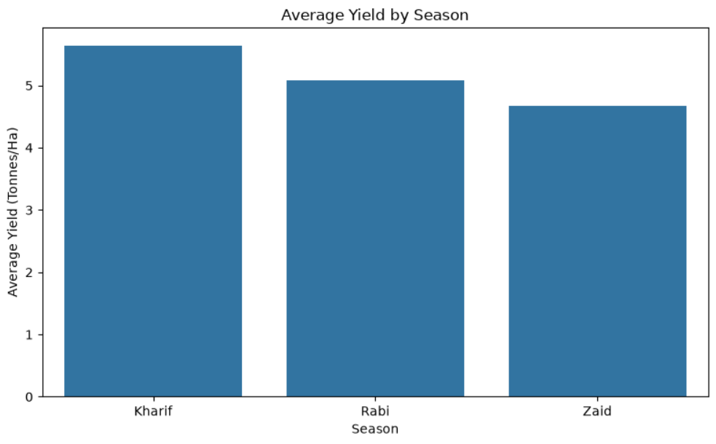
RESULTS: SEASONAL PERFORMANCE
Kharif records the highest average yield at approximately 5.6 tonnes/ha, followed by Rabi at 5.0 tonnes/ha and Zaid at 4.6 tonnes/ha. This highlights clear seasonal variation in agricultural productivity, with Kharif showing the strongest overall performance.

Slide 7
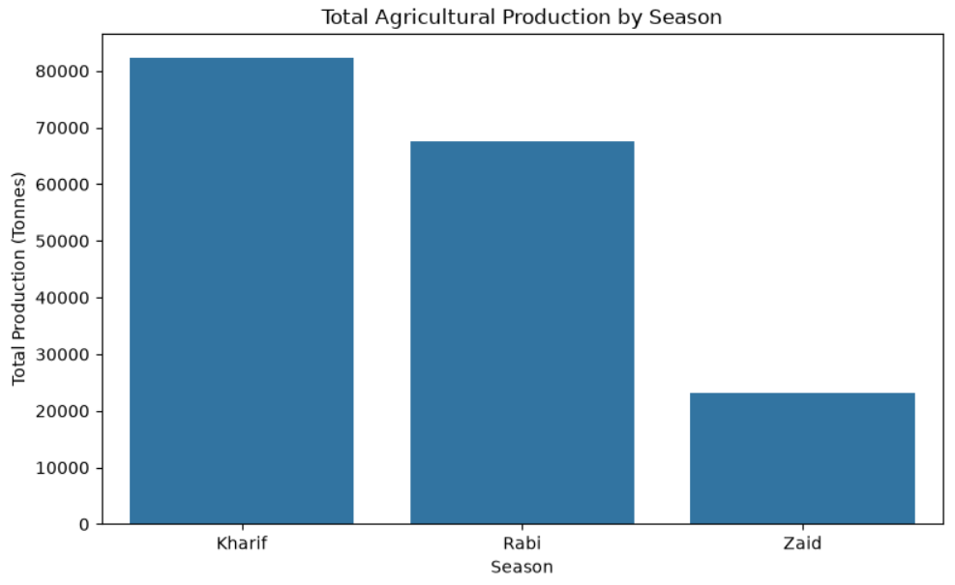
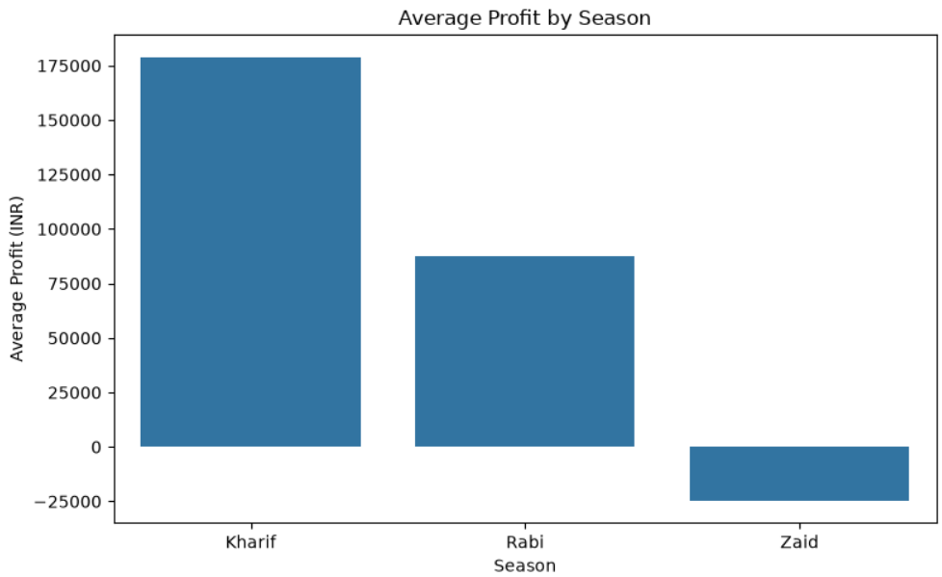
RESULTS :PRODUCTION AND PROFITABILITY
Kharif records the highest total production (82,388 tonnes) and the highest average profit (₹178,915). Rabi remains profitable on average (₹87,689), while Zaid records a negative average profit of ₹24,805. This shows that profitability varies substantially by season.

Slide 8
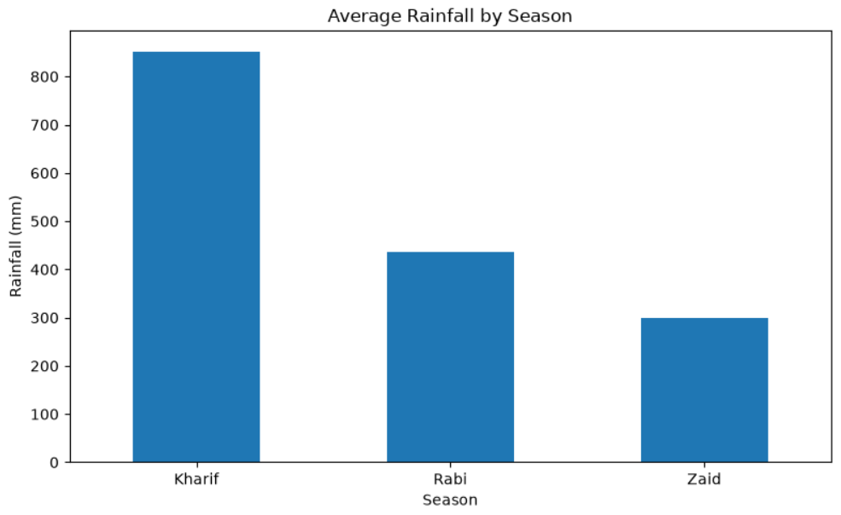
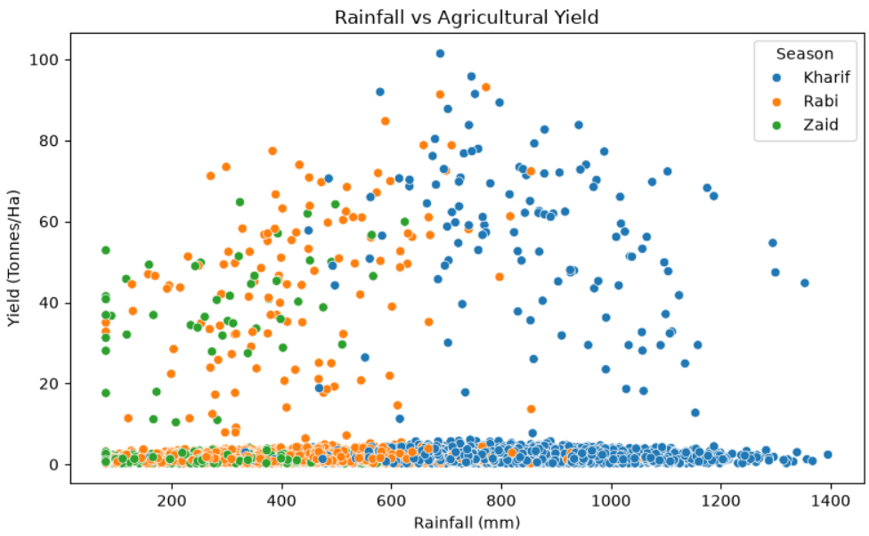
RESULTS : SEASONAL CONDITIONS AND YIELD
Kharif has the highest average rainfall (852 mm), followed by Rabi (436 mm) and Zaid (299 mm). The correlation between rainfall and yield is 0.03, indicating a very weak linear relationship in this dataset. Therefore, rainfall alone does not explain yield variation.

Slide 9
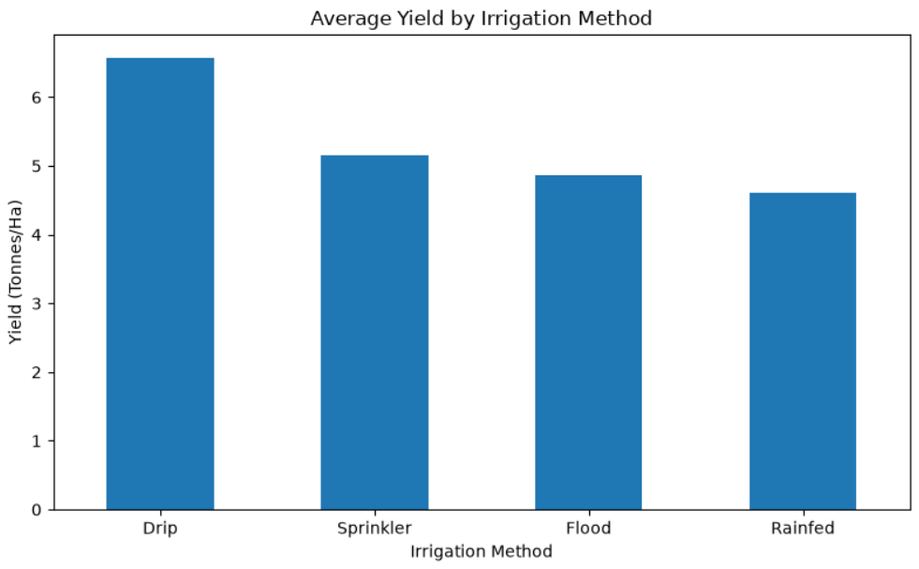
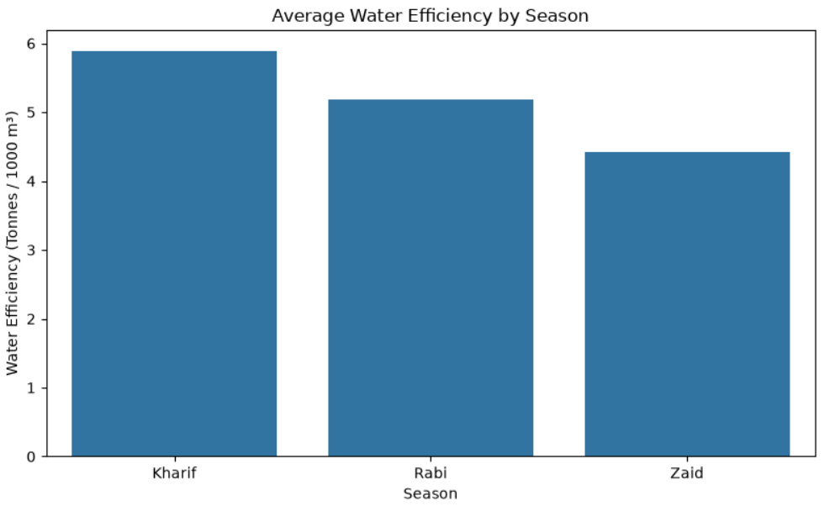
RESULTS : IRRIGATION AND WATER EFFICIENCY
Drip irrigation records the highest average yield at 6.58 tonnes/ha. Average water efficiency is highest in Kharif (5.89 t/1000 m³), followed by Rabi (5.19) and Zaid (4.41). The results show that irrigation practices and seasonal conditions are important dimensions for evaluating agricultural resource performance.

Slide 10
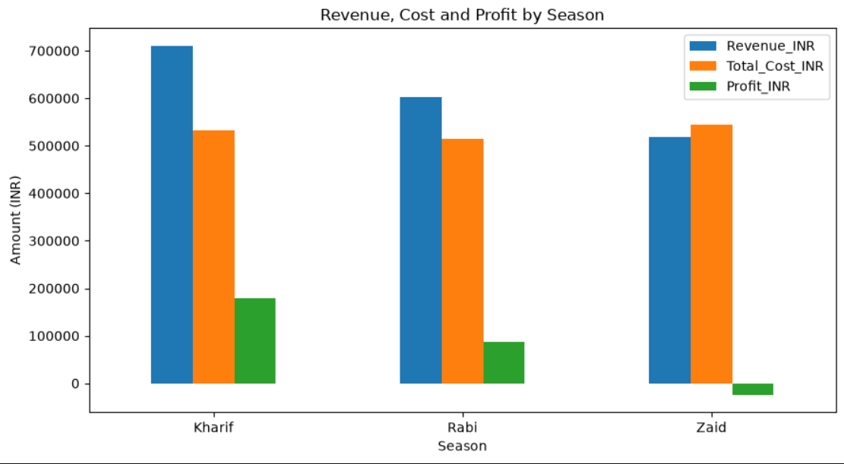
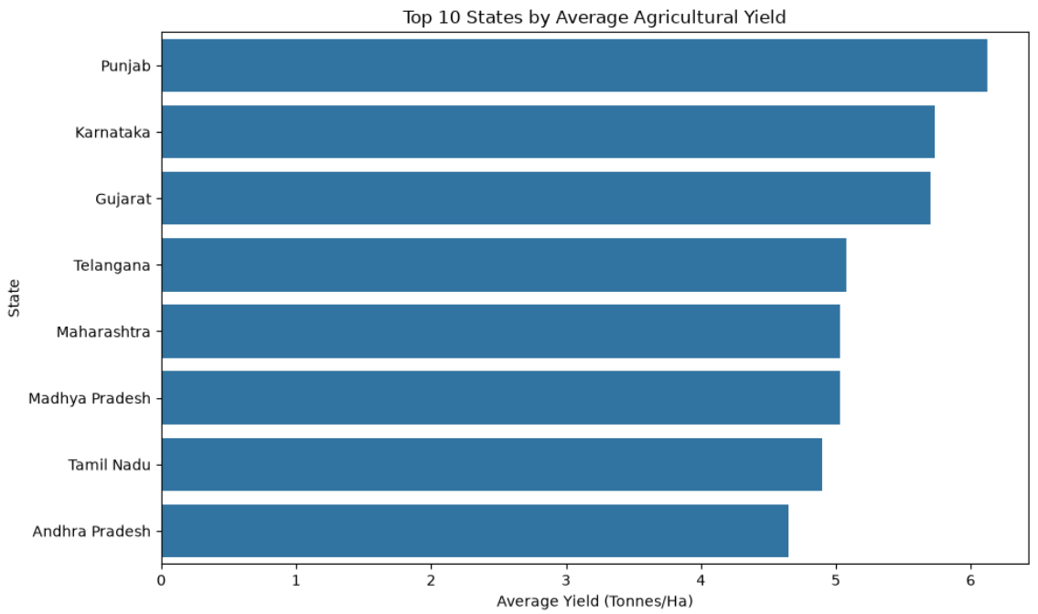
RESULTS:ECONOMIC AND REGIONAL ANALYSIS
Economic Comparison Regional Comparison
Kharif demonstrates the strongest economic performance, while Zaid records a negative average profit. Punjab has the highest average yield, highlighting regional differences in agricultural productivity.

Slide 11
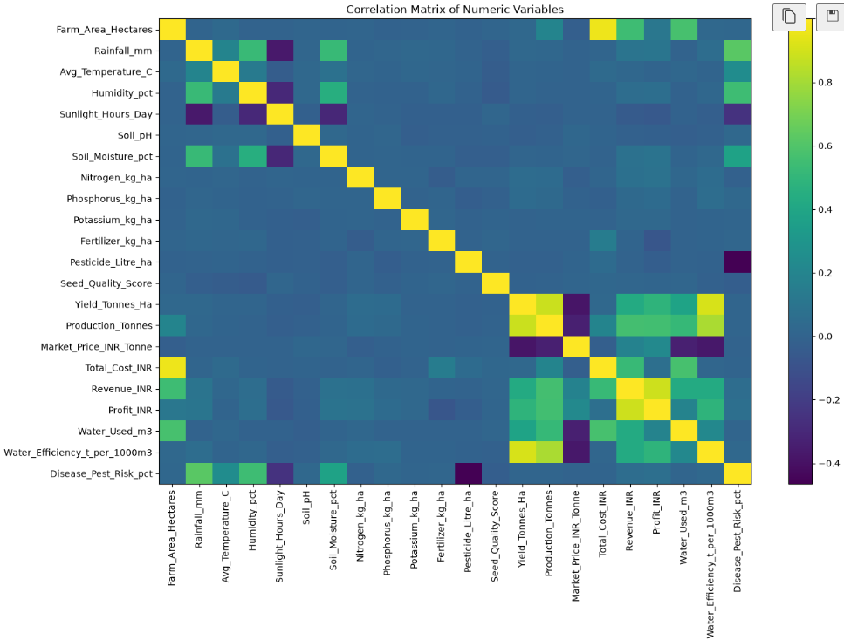
CORRELATION ANALYSIS OF AGRICULTURAL VARIABLES
The correlation analysis shows strong positive relationships between yield, production and water efficiency, while rainfall, temperature and soil moisture have weaker relationships with yield. This helps identify the variables most closely associated with agricultural performance.

Slide 12
Future scope
Develop a real-time agricultural performance dashboard.
Include weather forecasting and future seasonal predictions.
Apply Machine Learning for crop yield prediction.
Predict crop profitability based on seasonal conditions.
Provide region-specific crop recommendations.
Integrate real-time rainfall, soil and weather data.
Develop an interactive decision-support system for farmers and agricultural planners.

Slide 13
GitHub Link
https://github.com/shravi323/seasonal-agriculture-performance-analysis
The repository contains the project notebook, dataset and project documentation

Slide 14

VOIS Course completion certificate - Course name- Data Visualization

Slide 15
Thank you
Seasonal Agriculture Performance Analysis
- Shravani Waghawale
.
.

